Slide 1

Age of Information: A new metric proposed for measuring data freshness
Jiadong Lou,
University of Louisiana at Lafayette, Lafayette, Louisiana, USA

Slide 2

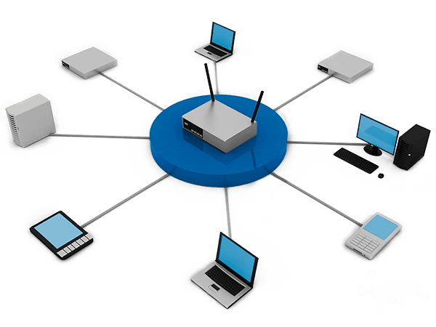

Data Freshness
Timely updates are essential in emerging applications of CPS/IoT
Smart Plant
Smart Home
Data freshness in WSN

Slide 3




Traditional Metrics
Limitation when describing “freshness”
Throughput——Network perspective
Rate of message delivery over network.
Delay——Data Packet perspective
Time for data traveling across the network
Inappropriate
Ambiguous

Slide 4



Age of Information
News Delivery Example
Take 1 day
to post
I read a 1-day-old news
Take 2 day
to post
AoI
Delay

Slide 5
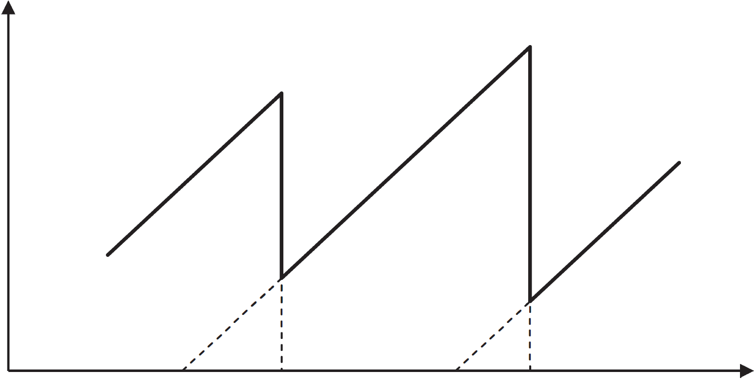

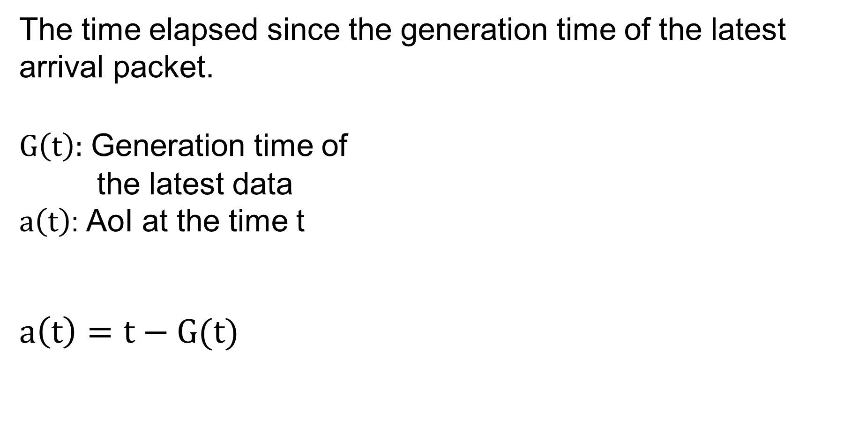




Age of Information
Definition
The time elapsed since the generation time of the latest arrival packet.
$G\left(t\right)$: Generation time of
the latest data
$a\left(t\right)$: AoI at the time t
$$a\left(t\right)=t−G(t)$$
$$a\left(t\right)$$
Packet arrived
$$t−G(t)$$
$$0$$
$$G\left(t\right)$$
$$t$$

Slide 6
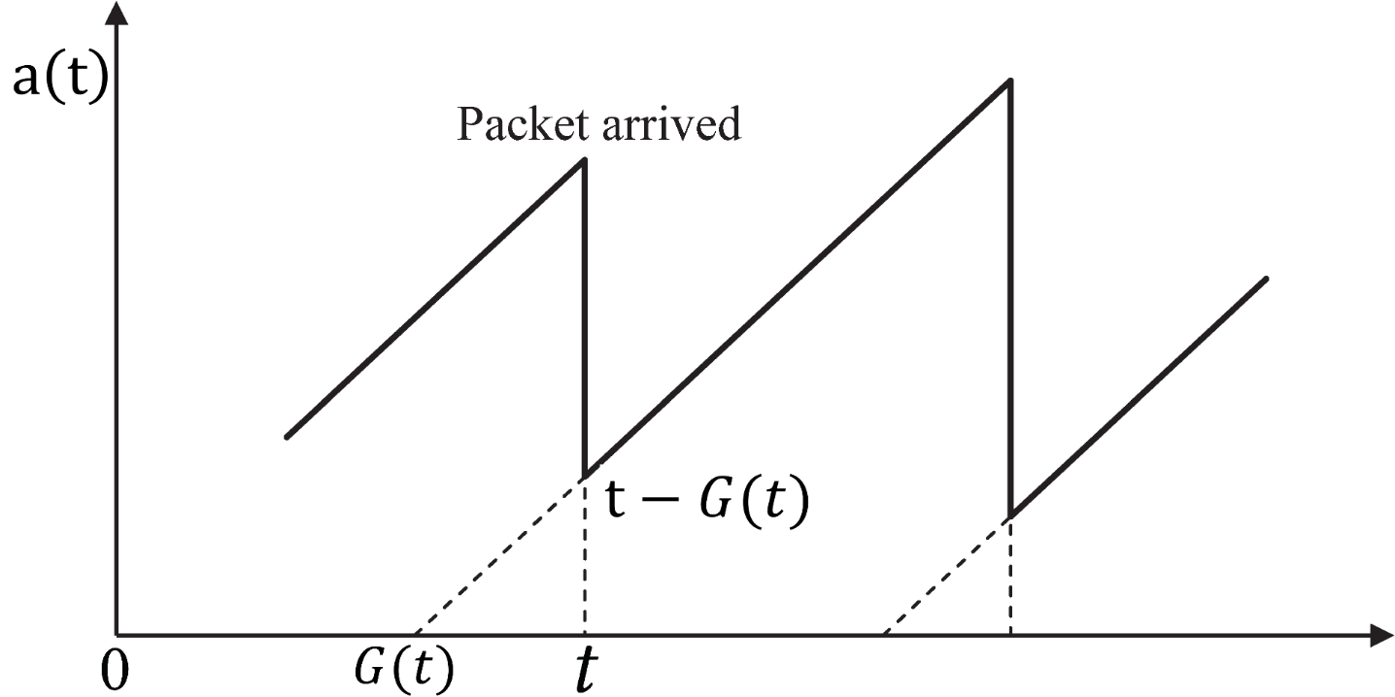
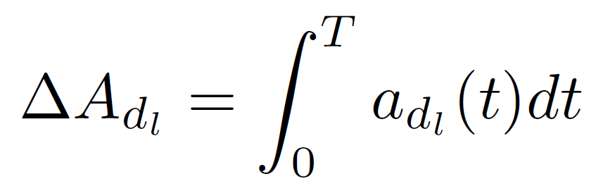
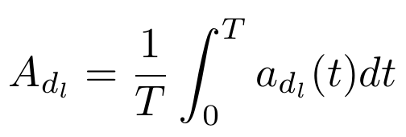
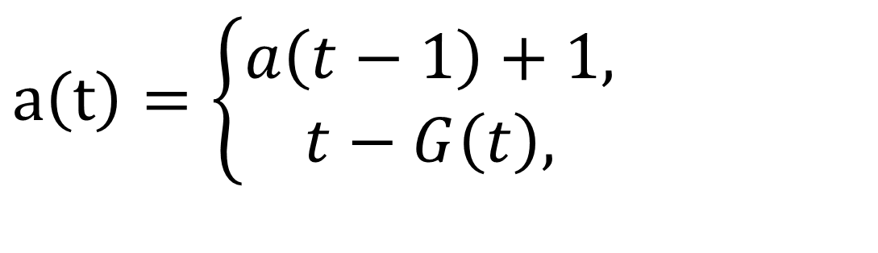
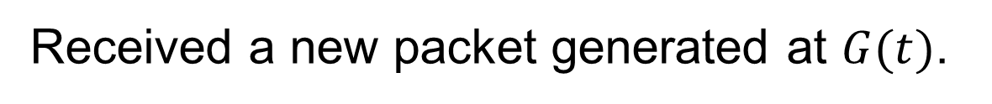
Age of Information
AoI Variation
$$a\left(t\right)=\left\{\begin{aligned}a\left(t−1\right)+1, \\ t−G\left(t\right),\end{aligned}\right.$$
No new packet arrived;
Received a new packet generated at $G(t)$.
Aggregated AoI
Time-averaged AoI

Slide 7
Age of Information
Data Transmission Example
N₁
N₂
Sink
Data Server
N₃
RR with cycle of 4
N₁
N₂
N₃
N₁
N₂
N₃
N₁
N₂
N₃
RR with cycle of 2
N₁
N₂
N₃
N₁
N₂
N₃

Slide 8
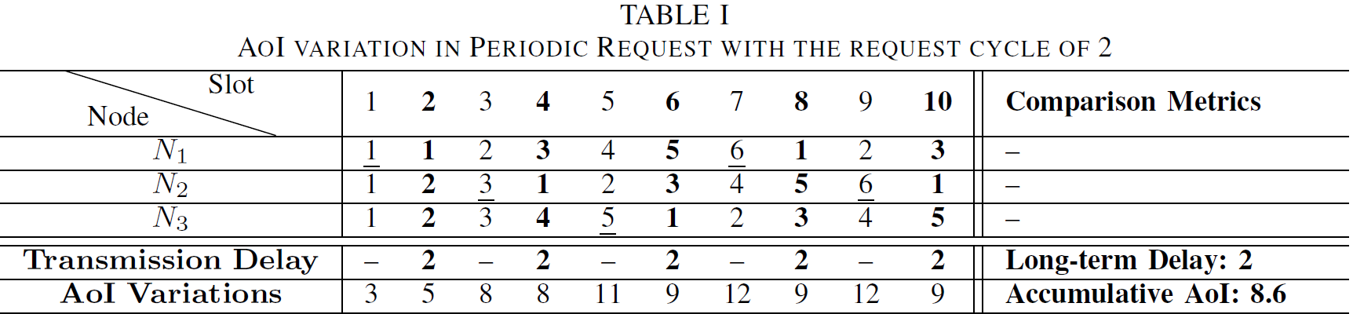
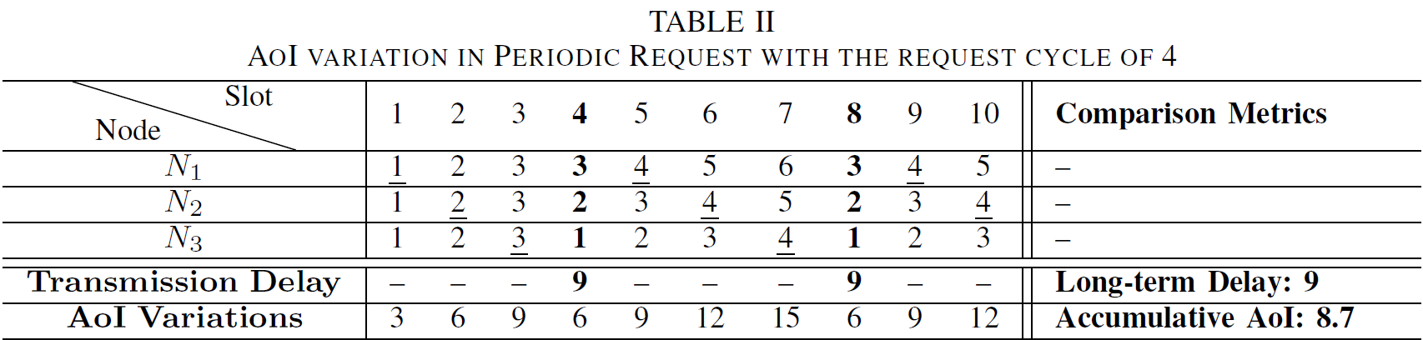
Age of Information
AoI and Delay Comparisons

Slide 9
Existing Work
Special network topologies
Interference-free link sets
Flexible routing
… …
Multi-hop
Applications scenario
Interference and throughput
Energy consuming
Broadcast network
Moving collection agents
… …
Single-hop
Generation rate control
Queuing packet management
Scheduling policies
… …

Slide 10

Instant AoI Optimization in IoT Networks with Packet Combination
Jiadong Lou, Xu Yuan, and Nian-Feng Tzeng
University of Louisiana at Lafayette, Lafayette, Louisiana, USA

Slide 11
Outline
New Metric
Instant AoI
Request Modes
Periodic Request
Proactive Request
Network Model
IoT Networks
Packet Combination

Slide 12
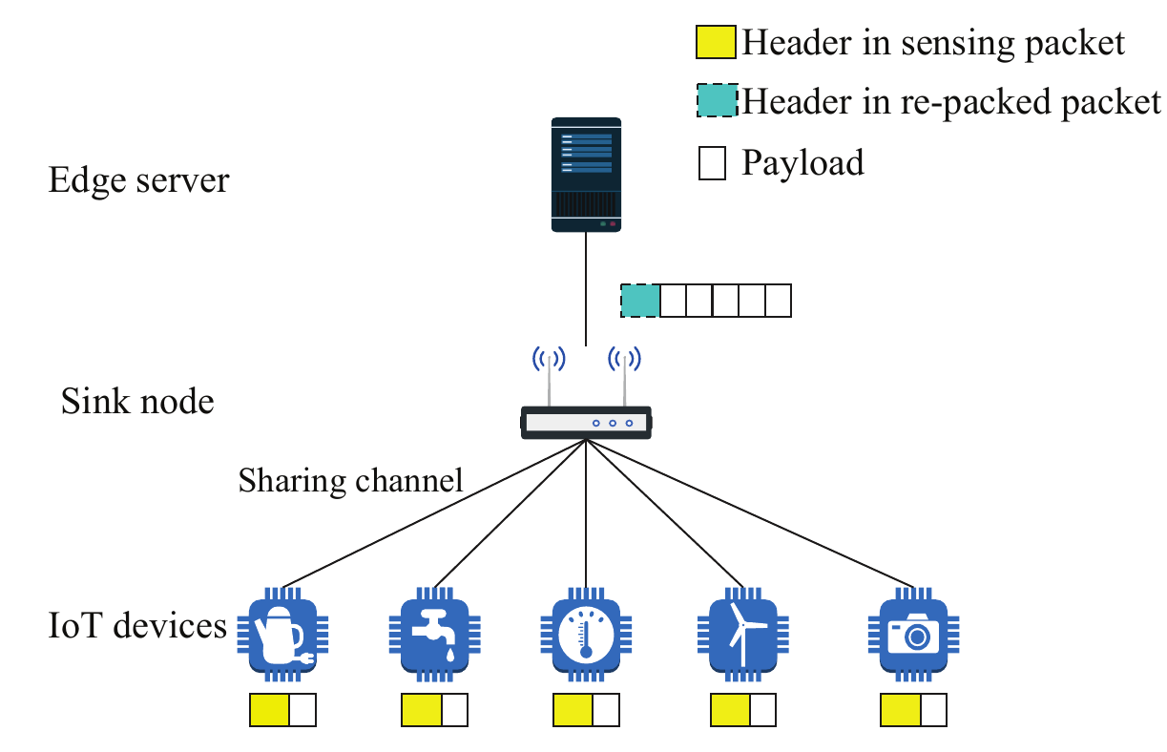
IoT Application
Packet Aggregation in the IoT Network
Packet Combination

Slide 13


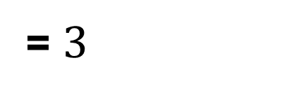
Packet Combination
Re-packing Rate and Transmission Time
1 time slot
1 time slot
1 time slot
Header
Payload
Re-packed header
Re-packing rate
= 2/3
2 time slots
Time slot for transmitting L packets:
= $3$

Slide 14

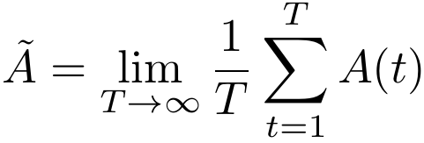
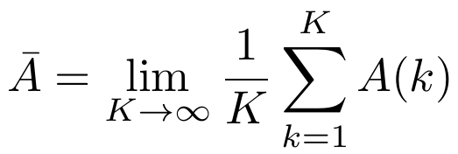







Instant AoI
AoI at Packet Delivered Time Point
Instant AoI
Time-averaged AoI
$$A\left(t\right)$$
Packet arrived
$$A\left(k\right)$$
Long-term Instant AoI
$$A\left(k−1\right)$$
$$0$$
$$t\left(k−1\right)$$
$$t\left(k\right)$$
$$t$$

Slide 15
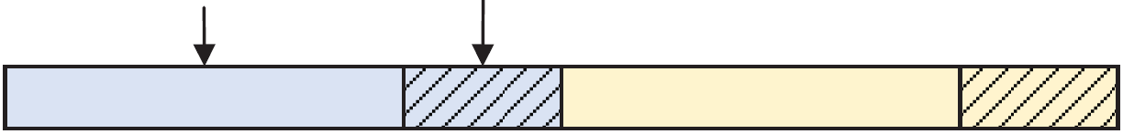
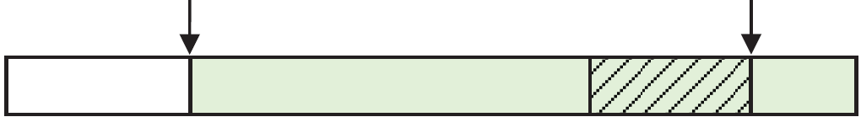
Request Modes
Periodic Request: Arrived in every T time slot
Proactive Request: Arrived arbitrarily
Sensing nodes’ uploading
Sink node’s uploading
T time slots
T time slots
Request arrived
Packet delivered
Within T time slots

Slide 16

Periodic Request
AoI Profit: The Value of decreased AoI
Profit：
AoI
b(h-1)
b(h)
Time interval between the two packets uploading

Slide 17
Periodic Request
Instant AoI Calculation
Instant AoI at H-th cycle
Initial AoI
Increased AoI
AoI Profit
Long-term Instant AoI
Latest uploading time slot
Scheduling parameter

Slide 18
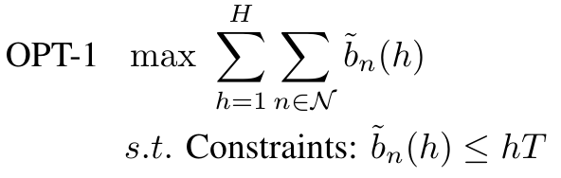
Periodic Request
Instant AoI Optimization
In a time slot, the node with minimum index uploads its new packet
3
Sink node’s uploading
2
1
Round Robin
T=3
b₁=0
b₂=0
b₃=0
b₁=1
b₂=2

Slide 19
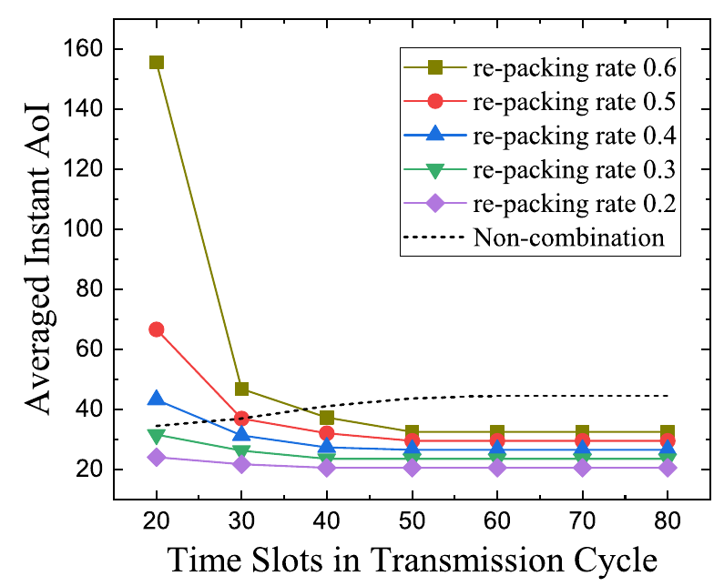
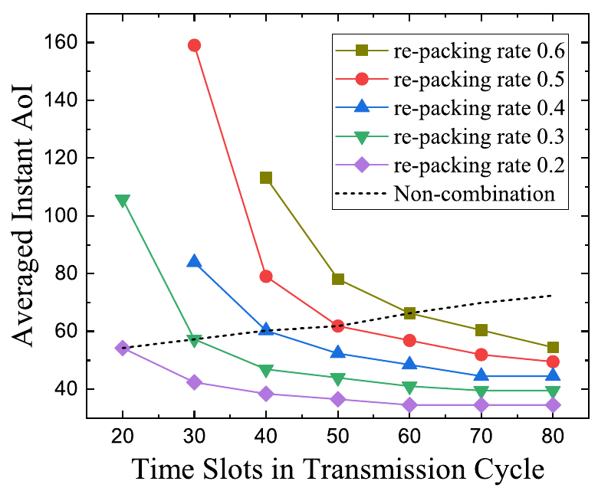
Numerical Results
30 Sensing Nodes
50 Sensing Nodes

Slide 20
Proactive Request
Instant AoI Calculation
Initial AoI
Increased AoI
AoI Profit
Sensing node uploading
Combined packet uploading

Slide 21
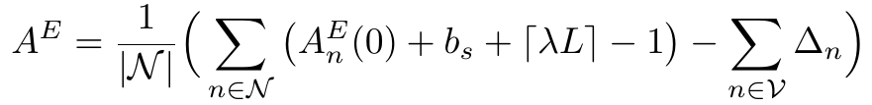
Proactive Request
Instant AoI Optimization
L packets from sensing nodes
L Minimum Initial AoIs

Slide 22
Proactive Request
Instant AoI Optimization
Iteratively calculating the optimal Instant AoI under different L values
L=3
Sink node’s uploading
Sorted with
initial AoI
Finished in 5 time slots
T=6

Slide 23
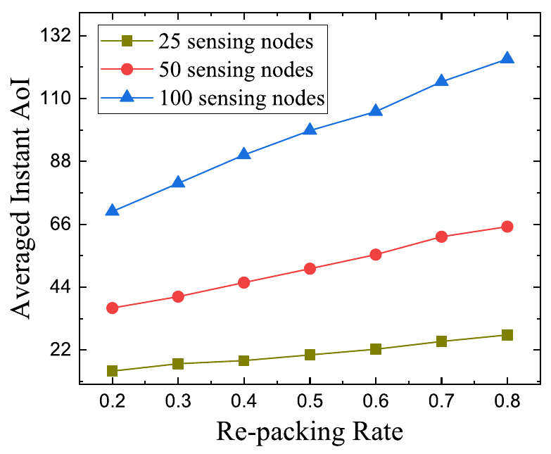
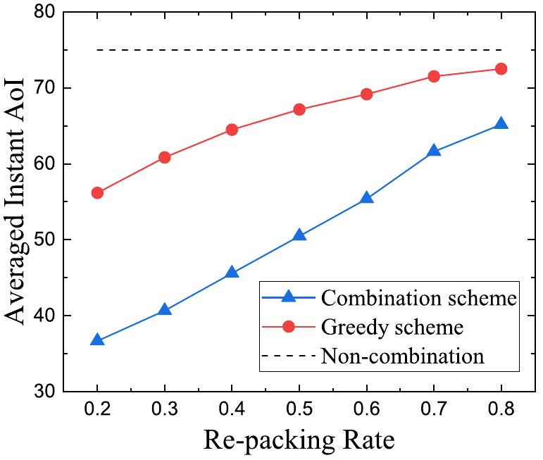
Numerical Results
Comparison under different sensing node counts and re-packing rates
Comparison with non-combination and greedy combination schemes

Slide 24

AoI and Throughput Tradeoffs in Routing-aware Multi-hop Wireless Network
Jiadong Lou∗, Xu Yuan∗, Sastry Kompella†, and Nian-Feng Tzeng∗
∗University of Louisiana at Lafayette, Lafayette, Louisiana, USA
†U.S. Naval Research Laboratory, Washington D.C., USA

Slide 25
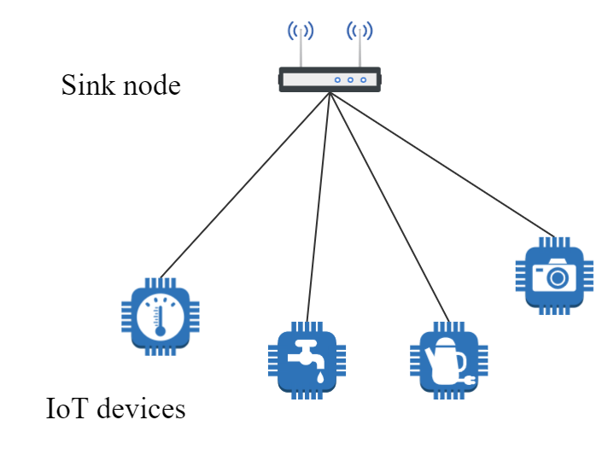
Motivation
AoI and Throughput Tradeoffs
Smart Home : Plenty of smart devices deployed to gather information
Lower AoI: timely responses for urgent events
High throughput: massive data uploads

Slide 26
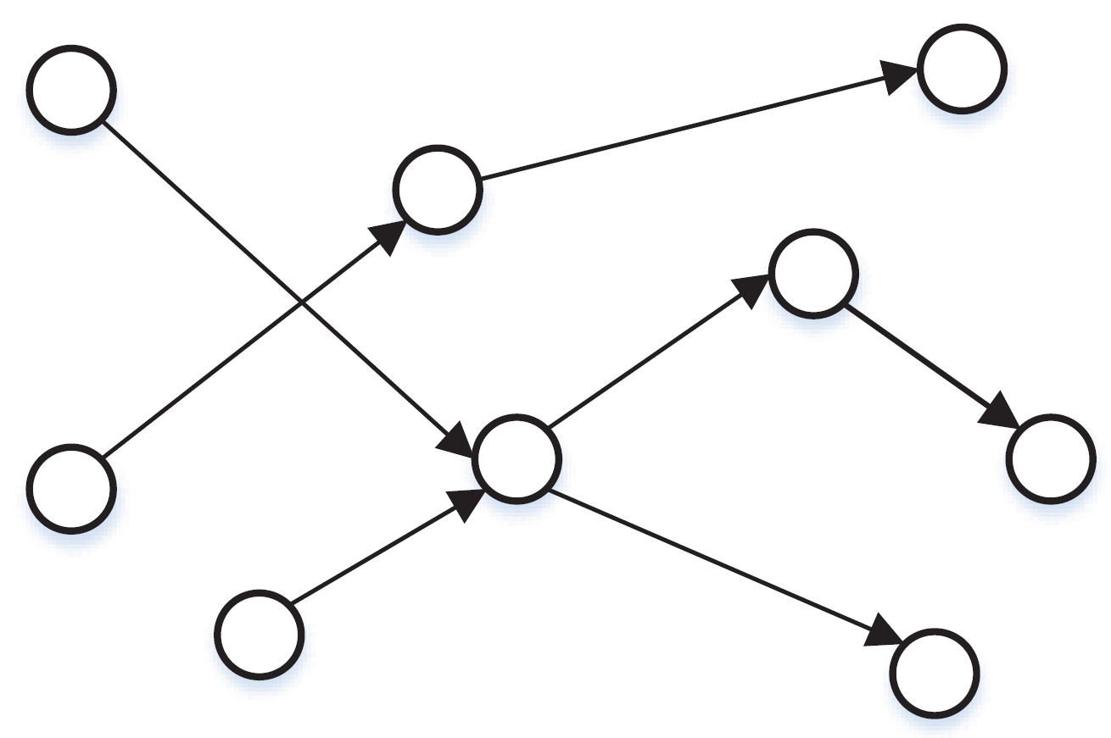
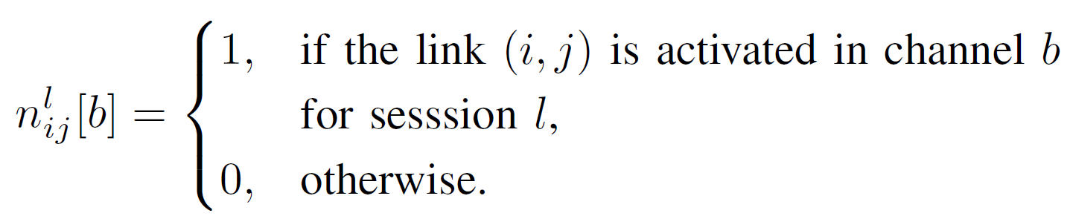
Network Modeling
OFDM-based Multi-hop Wireless Networks
Node j
B Channels
Session 1
Node i
Session 2
Session 3

Slide 27
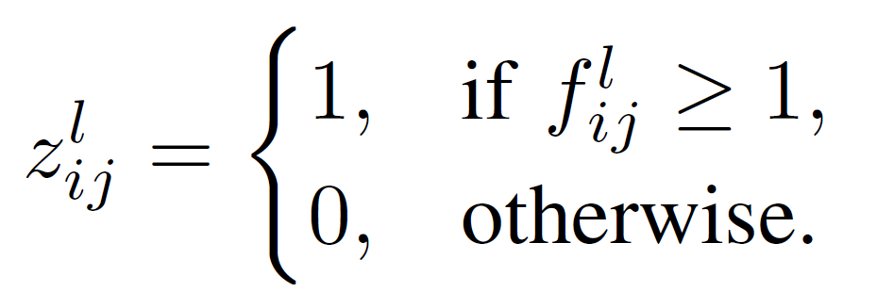
Network Modeling
Link Activation and Frequency
Frequency
Activation Indicator

Slide 28
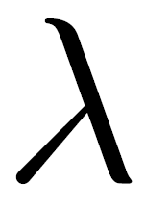
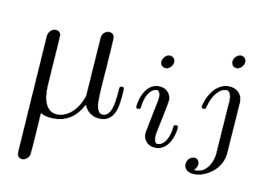

Network Modeling
Transmission and Throughput
Generation rate at source:
Transmission rate at link (i, j):
Link capacity
Throughput:

Slide 29
Interfernce Modeling
Three Types of Interference

Slide 30
Flexible Routing Modeling
Routing Models of three nodes

Slide 31
AoI Calculation
Accumulated Trapezoid Areas
Source node
Node a
Destination node

Slide 32
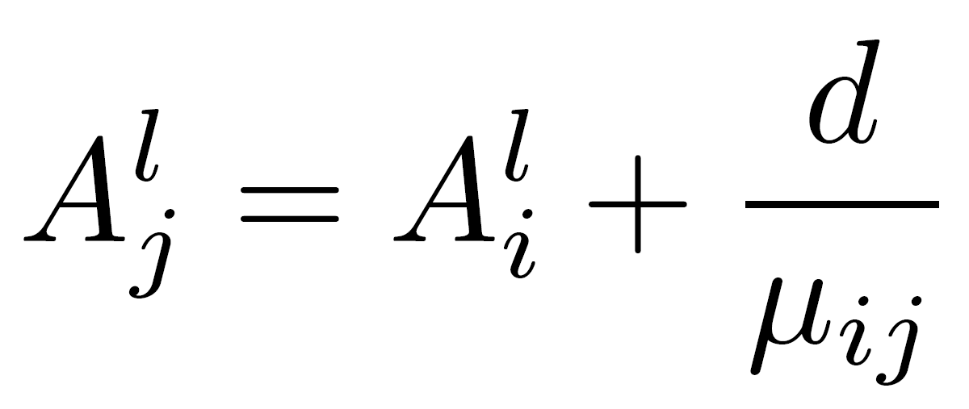
AoI Calculation
AoI Variations at Two Consecutive Nodes

Slide 33
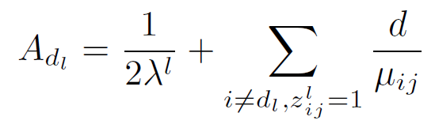
AoI Calculation
AoI at Destination Node
Source node
Destination node
Node a

Slide 34
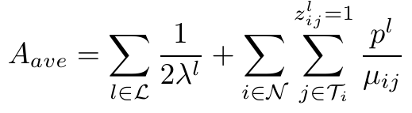
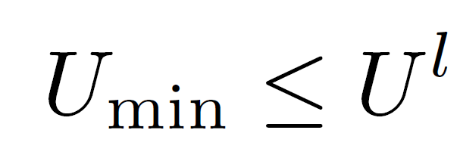
Multi-objective Problem
Minimize time-averaged AoI
Maximize Throughput

Slide 35
Pareto-optimal
Minimizing Two Objectives
Cannot make one individual metric better without making others worse

Slide 36
Local Optimal Throughput
A scheduling including routing and channel allocation for optimizing AoI
Throughput
Bottleneck
Rate 3=105
Rate 2=65
Rate 1=97
Maximum Throughput achieved as the bottleneck rate

Slide 37

Algorithm Design
1. Solve the optimization problem that merely minimizing the AoI
Get the global minimum AoI: A_{ave}
Get the local maximum throughput:
AoI
(A_{ave}, v)
Throughput

Slide 38
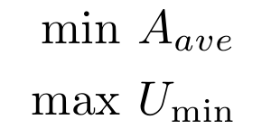
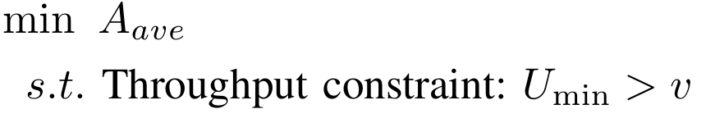
Algorithm Design
2. Add a throughput constraint to construct AoI optimization problem
AoI
(A_{ave}, v)
U > v
Throughput

Slide 39
Algorithm Design
3. Repeat the step 2 until no feasible solutions
U > v
U > v
AoI
AoI
Throughput
Throughput

Slide 40
Pareto-optimal Curve
Obtain all Pareto-optimal points
Better Throughput
AoI
Lower AoI
Throughput
We prove that all Pareto-optimal points can be found

Slide 41
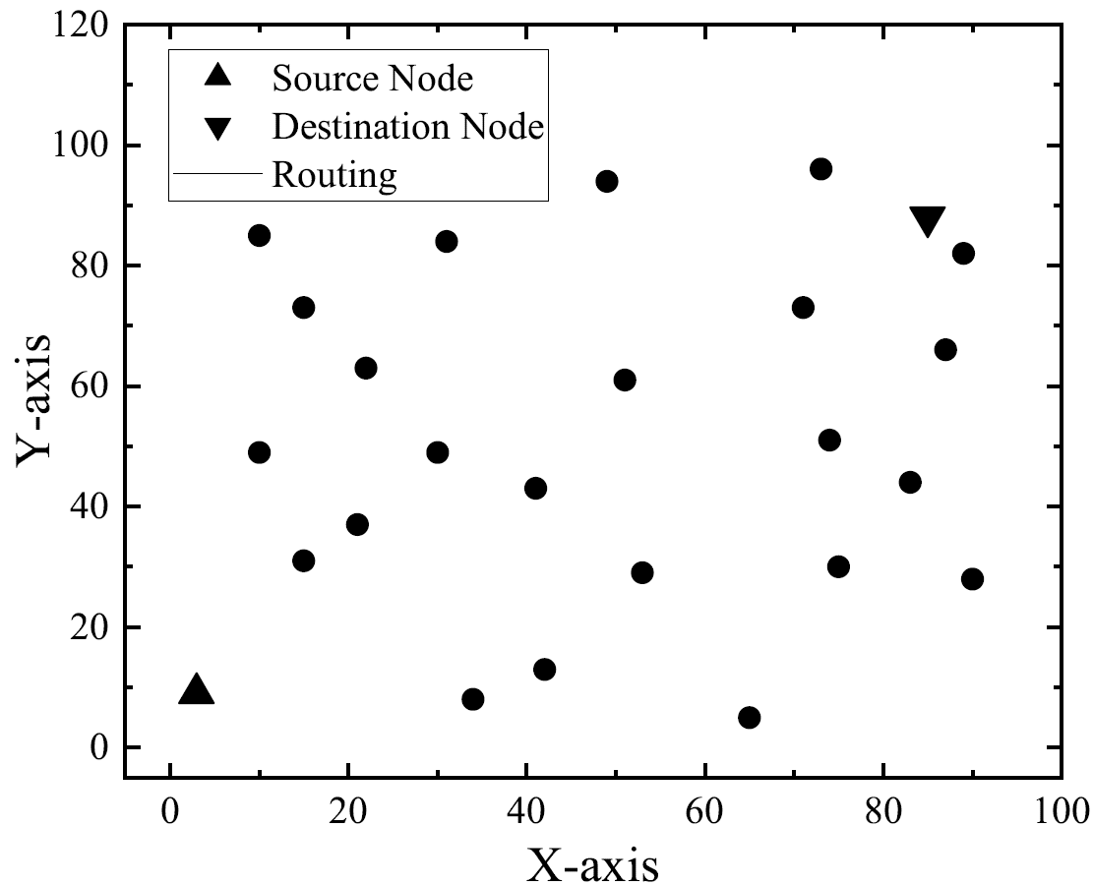
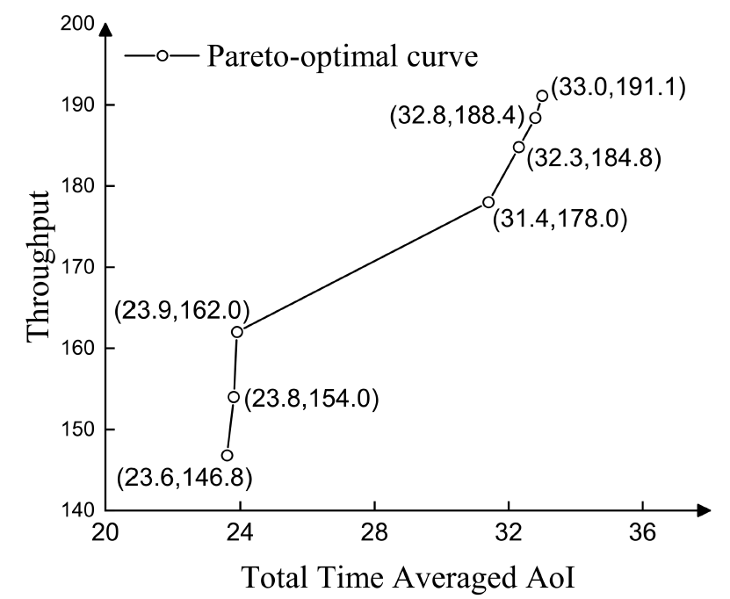
Simulation Results
Randomly generate a 25-node network.

Slide 42
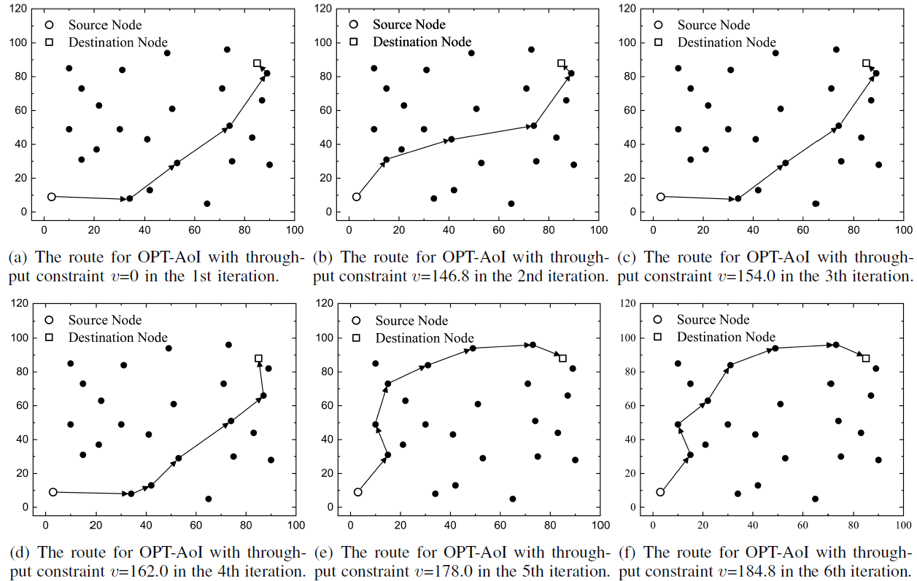
Simulation Results
Routing Variations

Slide 43
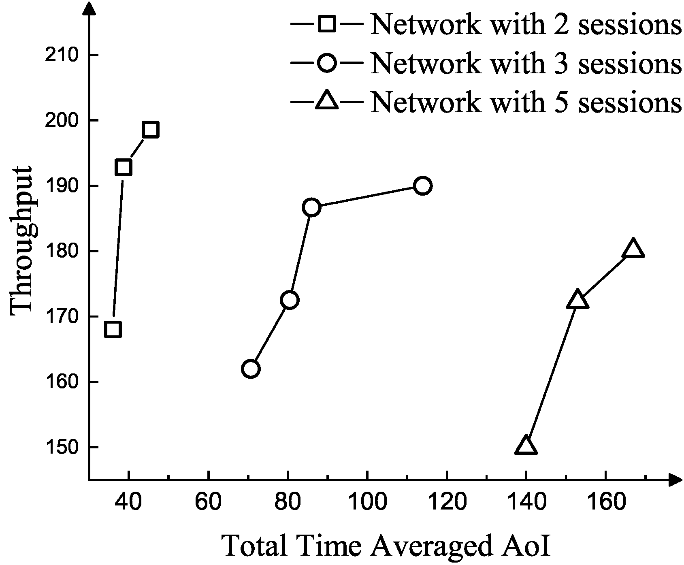
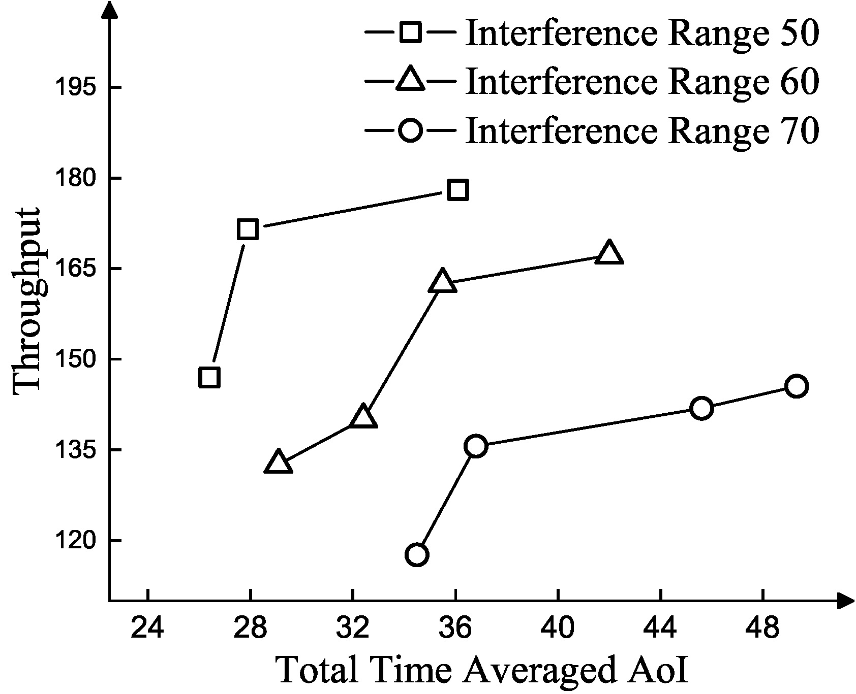
Simulation Results
Different number of sessions
Different interference ranges

Slide 44
Thank You
Q&A

